Slide 1

Mathematic Models of Systems
Ref: Chapter 2: Dorf, R. C. & Bishop, R. H. ,
Modern Control Systems
Chapter 2: Nise, N. S.
Control System Engineering
Dr Pavan Chakraborty
IIIT-Allahabad
Indian Institute of Information Technology - Allahabad

Slide 2
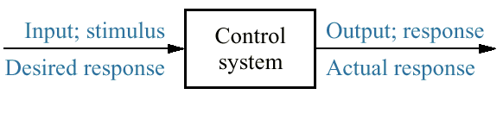
Figure 1.1 Simplified description of a control system

Slide 3
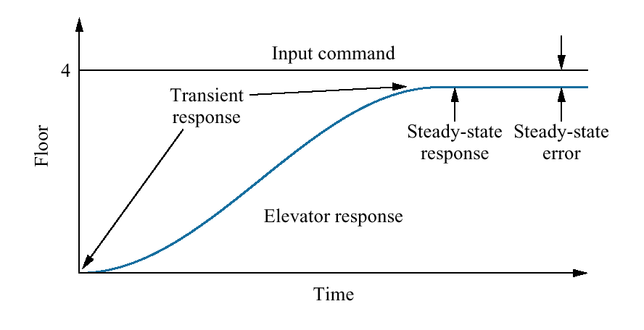
Figure1.5 Elevator input and output

Slide 4
The Birth of Mathematical Control Theory
The design of feedback control systems up through the Industrial Revolution was by trial-and-error together with a great deal of engineering intuition. Thus, it was more of an art than a science.
In the mid 1800's mathematics was first used to analyze the stability of feedback control systems. Since mathematics is the formal language of automatic control theory, we could call the period before this time the prehistory of control theory.
Indian Institute of Information Technology - Allahabad

Slide 5
In 1840, the British Astronomer Royal at Greenwich, G.B. Airy, developed a feedback device for pointing a telescope. His device was a speed control system which turned the telescope automatically to compensate for the earth's rotation, affording the ability to study a given star for an extended time.
Unfortunately Airy discovered that by improper design of the feedback control loop, wild oscillations were introduced into the system.
He was the first to discuss the instability of closed-loop systems, and the first to use differential equations in their analysis [Airy 1840].
Airy, G.B., "On the Regulator of the Clock-Work for Effecting Uniform Movement of Equatorials," Memoirs of the Royal Astronomical Society, vol. ll, pp. 249-267, 1840.
Indian Institute of Information Technology - Allahabad

Slide 6
Differential Equations
The theory of differential equations was by then well developed, due to the discovery of the infinitesimal calculus by Newton (1642-1727) and G.W. Leibniz (1646-1716), and the work of the brothers Bernoulli (late 1600's and early 1700's), J.F. Riccati (1676-1754), and others.
The use of differential equations in analyzing the motion of dynamical systems was established by J.L. Lagrange (1736-1813) and W.R. Hamilton (1805-1865).
Indian Institute of Information Technology - Allahabad

Slide 7
Stability Theory
The early work in the mathematical analysis of control systems was in terms of differential equations.
J.C. Maxwell analyzed the stability of Watt's flyball governor [Maxwell 1868].
His technique was to linearize the differential equations of motion to find the characteristic equation of the system. He studied the effect of the system parameters on stability and showed that the system is stable if the roots of the characteristic equation have negative real parts.
With the work of Maxwell we can say that the theory of control systems was firmly established.
Maxwell, J.C., "On Governors," Proc. Royal Soc. London, vol. 16, pp. 270-283, 1868.
Indian Institute of Information Technology - Allahabad

Slide 8
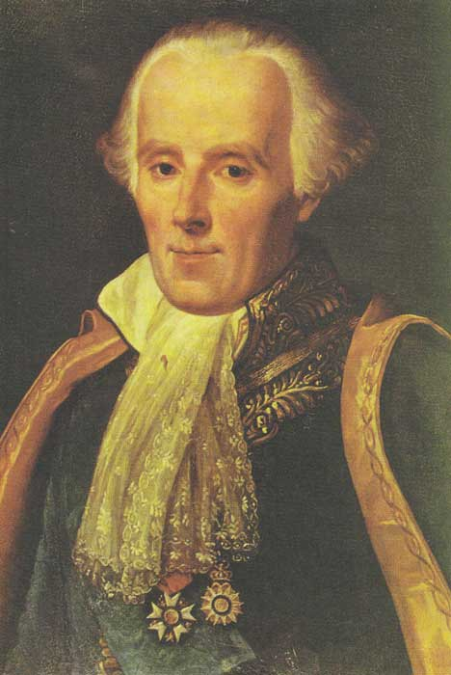
Frequency-Domain Analysis
The mathematical analysis of control systems had heretofore been carried out using differential equations in the time domain. At Bell Telephone Laboratories during the 1920's and 1930's, the frequency domain approaches developed by P.-S. de Laplace (1749-1827), J. Fourier (1768-1830), A.L. Cauchy (1789-1857), and others were explored and used in communication systems.
Pierre Simon, Marquis de Laplace
Indian Institute of Information Technology - Allahabad

Slide 9
Linear Time-Invariant (LTI) Systems
A continuous-time system accepts an input signal, x(t), and produces an output signal, y(t). A system is often represented as an operator "S" in the form
x(t)
S
y(t)
y(t) = S [x(t)]
Indian Institute of Information Technology - Allahabad

Slide 10
Linear Time-Invariant (LTI) Systems
LTI Systems A linear continuous-time system obeys the following property: For any two input signals x₁(t), x₂(t), and any real constant a, the system responses satisfy
S [ x₁(t) + x₂(t)] = S [x₁(t)] + S [x₂(t)]
= y₁(t) + y₂(t)
Principle of Superposition
S [ a x₁(t) ] = a S [x₁(t) ]
= a y₁(t)
Property of Homogeneity
A linear system satisfies the properties of superposition and homogeneity
Indian Institute of Information Technology - Allahabad

Slide 11
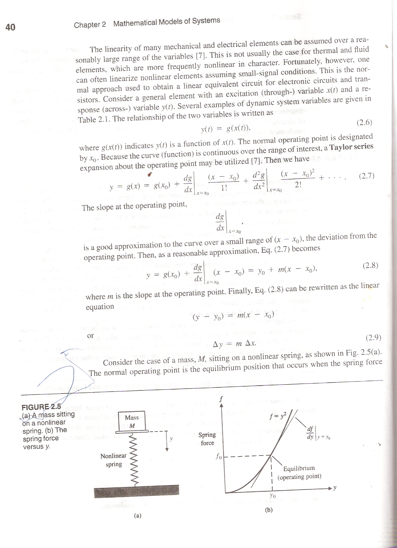
Non-Linear Systems
y = x²
Not linear ----- Superposition property not satisfied
[ x₁(t) + x₂(t)]² = [x₁(t)]² + [x₂(t)]² + 2 [x₁(t)][x₂(t)]
≠ [x₁(t)]² + [x₂(t)]² = y₁(t) + y₂(t)

Slide 12
y(t) = S [x(t)]
Taylor Series
( y – y₀ ) = m ( x - x₀ )
Δy = m Δx

Slide 13
The Laplace Transform
The use of frequency-domain methods in the study of LTI systems and signals is very useful.
One such method is the Laplace Transform method, which is commonly used in the study of continuous-time (analog) systems.
Developed by Pierre Simon Marquis de Laplace (1749-1827).
Indian Institute of Information Technology - Allahabad

Slide 14
BILATERAL AND UNILATERAL LAPLACE TRANSFORM
Let f (t ) be any given function that is defined for all time,
t ∈ ℜ (i.e. from −∞ to + ∞ ).
If we multiply f (t ) with exp(−st ) and if their integral from
t = −∞ to t = +∞ exists, then the resulting function will be a function of the variable s, in which
is the mathematical definition of a bilateral Laplace transform.
Indian Institute of Information Technology - Allahabad

Slide 15
where, f (t ) is a non-causal signal of the time domain t, and the variable s is a complex variable of the form s=σ +jω , with σ and ω the real and imaginary parts,respectively.
When σ = 0 , → s= jω ,
the bilateral Laplace transform becomes the Fourier transform of f(t).
Indian Institute of Information Technology - Allahabad

Slide 16
Unilateral Laplace transform, or simply,
the Laplace transform,
EXAMPLE 1
Determine the Laplace transform of the causal function f (t) = t.
Indian Institute of Information Technology - Allahabad

Slide 17
PROPERTIES OF THE LAPLACE TRANSFORM
There are a lot of useful properties of the Laplace transform that can sometimes allow one to solve a problem by inspection.
LINEARITY
Let f (t ) be any given function that is composed of two sub-functions f ₁(t ) and f ₂(t ) , in which the relationship
f (t ) = f ₁(t ) + f ₂(t ) exists. The Laplace transform F(s) of f (t ) then becomes
Indian Institute of Information Technology - Allahabad

Slide 18
TIME SHIFTING
Let f (t ) be any signal in which t ≥ 0 is satisfied.
If f (t ) is transformable to F (s) (i.e. f (t) ←→ F(s) ),
then for any positive real number τ (i.e. τ ∈ ℜ ),
DOMAIN SHIFTING
Let f (t ) be any signal in which t ≥ 0 is satisfied.
If f (t) ←→ F(s) exists, then
Indian Institute of Information Technology - Allahabad

Slide 19
TIME SCALING
Let f (t ) be any signal in which t ≥ 0 is satisfied.
If f (t)↔F(s) exists, then for any positive real number a ,.
DIFFERENTIATION IN THE TIME DOMAIN
Let f (t ) be any signal in which t ≥ 0 is satisfied. If f (t)↔F(s) exists, then
Indian Institute of Information Technology - Allahabad

Slide 20
INTEGRATION IN THE TIME DOMAIN
Let f (t ) be any signal in which t ≥ 0 is satisfied. If f (t)↔F(s) exists, then
DIFFERENTIATION IN THE s DOMAIN
Let f (t ) be any signal in which t ≥ 0 is satisfied. If f (t)↔F(s) exists, then
Indian Institute of Information Technology - Allahabad

Slide 21
MODULATION
Let x (t ) be any signal in which t ≥ 0 is satisfied. If x(t)↔X(s) exists, then for any real number ω ,
CONVOLUTION
Let f (t ) and g(t) be any signals in which t ≥ 0 is satisfied.
If f (t) ↔F(s) and g(t) ↔G(s) exist, then
Indian Institute of Information Technology - Allahabad

Slide 22
INITIAL VALUE THEOREM
The initial value theorem is useful because it allows us to compute for the initial value of a signal f (t ) and its derivatives directly from the Laplace transform F (s) without having to
find the inverse.
Let f (t ) be any signal in which t ≥ 0 is satisfied.
Also, let f (t ) be infinitely differentiable on an interval around
f (0+ ). If f (t) ↔F(s) exists, then
The equation to the right is a more general form of the initial value theorem
Indian Institute of Information Technology - Allahabad

Slide 23
FINAL VALUE THEOREM
The final value theorem is useful especially in control theory, where we may need to find the final value of the output signal of the system without solving from the time-domain function f (t ) . Let f (t ) be any signal in which t ≥ 0 is satisfied. If
f (t) ↔F(s) exists, then
Indian Institute of Information Technology - Allahabad

Slide 24
EXAMPLE 1
Determine the Laplace transform of the function f (t) = 1.
SOLUTION
The Laplace transform of the function f (t) = 1 is

Slide 25
EXAMPLE 2
Determine the Laplace transform of the function f (t) =e^{kt}
.
SOLUTION
The Laplace transform of the function f (t) =e^{kt} is

Slide 26
First shifting theorem:
If any function f (t ) has a transform F(s) , then the product of f (t ) and e^{kt} has a transform F(s−k), that is
If we take the inverse of both sides, the relationship becomes

Slide 27
LAPLACE TRANSFORMATION OF INTEGRO-DIFFERENTIAL EQUATIONS
A useful method in solving for the solutions of differential equations and corresponding initial and boundary value problems is the Laplace transformation method.
Laplace transforms reduce differential equation problems into algebraic problems, which make this method much simpler than classical methods.
Differential Equation Problems
Algebraic Problems
Replaces operations of calculus by operations of algebra on transforms.
Indian Institute of Information Technology - Allahabad

Slide 28
TRANSFORMS OF DERIVATIVES AND INTEGRALS
Suppose that a function f (t ) is continuous for all t ≥ 0 and has a derivative f ′(t ) that is piecewise continuous on every finite interval in the range t ≥ 0 .
Then the Laplace transform of the derivative f ′(t ) exists, that is
Similarly for a derivative of any order n, f ^{n}(t ) , the Laplace transform of the n^{th}-derivative f ^{n}(t ) is given by
Indian Institute of Information Technology - Allahabad

Slide 29
EXAMPLE 3
Determine the Laplace transform of differential equation
y′′+2y′−3=exp(2t) for y (0) =0 and y′(0) =0. .
SOLUTION
RHS:
LHS:

Slide 30
SOLUTION to Example 3 (Continued)
Therefore, the Laplace transform of the differential equation is

Slide 31
Piecewise Continuous Function
If f (t ) is a piecewise continuous function for any time t ≥ 0 , then the Laplace transform F (s) of the original function f (t ) is
or, if we take the inverse transform on both sides:

Slide 32
EXAMPLE 4
Determine the Laplace transform of the integro-differential equation
SOLUTION
The Laplace transform of the RHS, which is a unit-step function is 1/s . For the LHS, the Laplace transform is as follows

Slide 33
SOLUTION to Example 4 (Continued)

Slide 34
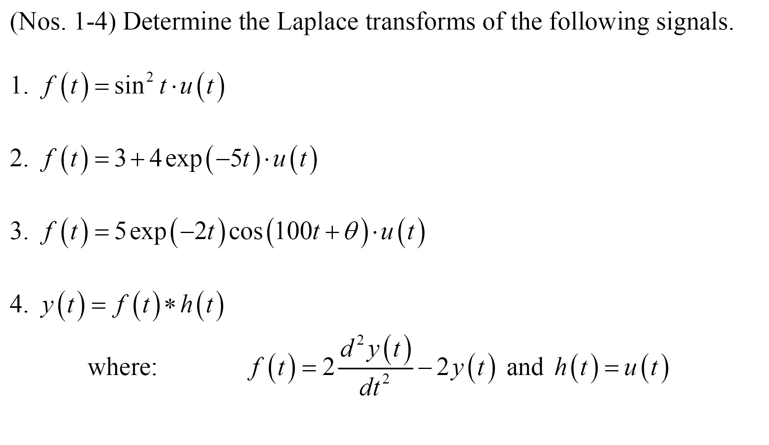
PRACTICE PROBLEMS (Laplace Transform)

Slide 35
THE INVERSE-LAPLACE TRANSFORM
By definition, the inverse-Laplace transform of a signal F(s) is
where, the integral is evaluated along the straight line σ + jω in the complex plane from σ − j∞ to σ + j∞, where σ is any FIXED real number (i.e. σ ∈ℜ). Evaluation of the integral in this equation requires the use of contour integration
in the complex plane, which is difficult to obtain.
+∞
j
σ
ℜ
-∞
Indian Institute of Information Technology - Allahabad

Slide 36
Since the Laplace transform of a system can be expressed as a ratio of s polynomials, in which
where, N(s) and D(s) are the numerator and denominator s polynomials, respectively.
We can therefore expand the ratio by using partial fraction expansion techniques, which is easier than performing contour integration.
Once the partial fraction expansion is obtained, the inverse-Laplace transform can then be obtained by using the Laplace transforms table in Appendix A.(Dorf & Bishop page799)
Indian Institute of Information Technology - Allahabad

Slide 37
Partial Fraction Expansion
The method of partial fraction expansion, in which a ratio of polynomials can be split into a sum of small polynomials.
Here's an example of one ratio being split into a sum of three simpler ratios:
CHECK:
http://cnx.org/content/m2111/latest/
Indian Institute of Information Technology - Allahabad

Slide 38
Finding Partial Fractions in Matlab
Matlab can be a useful tool in finding partial fraction expansions when the ratios become too unwieldy to expand by hand.
It can handle symbolic variables. For example, if you type “syms s”, “s” will be treated as a symbolic variable. You can then use it as such when you make function assignments.
If you've done this and have then made a function, say H(s), which is a ratio of two polynomials in the symbolic variable “s”, there are two ways to get the partial fraction expansion of it. A trick way is to say diff(int(H)). When you use these functions together, Matlab gives back H expanded into partial fractions. There's also a more formal way to do it using the residue command. Type help residue in Matlab for details.
Indian Institute of Information Technology - Allahabad

Slide 39
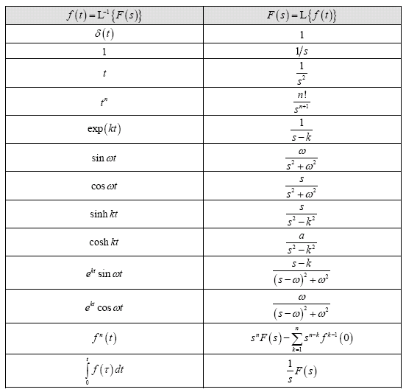
TABLE OF LAPLACE TRANSFORMS
Indian Institute of Information Technology - Allahabad

Slide 40
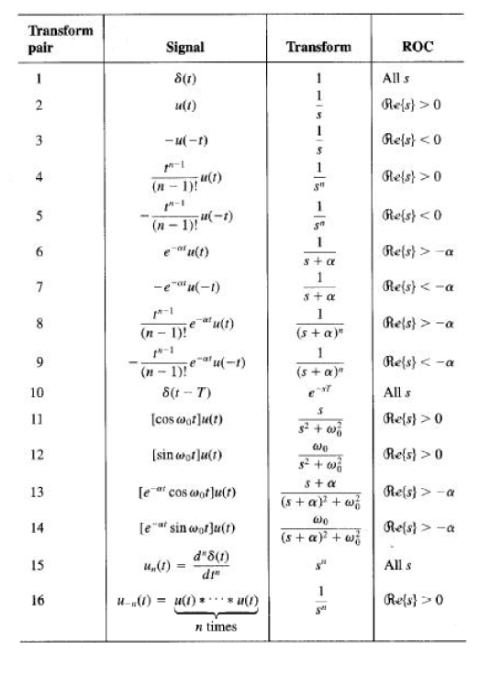
TABLE OF LAPLACE TRANSFORMS
Indian Institute of Information Technology - Allahabad

Slide 41
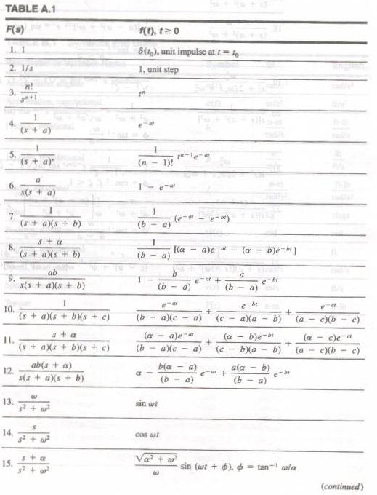
TABLE OF LAPLACE TRANSFORMS
Indian Institute of Information Technology - Allahabad

Slide 42
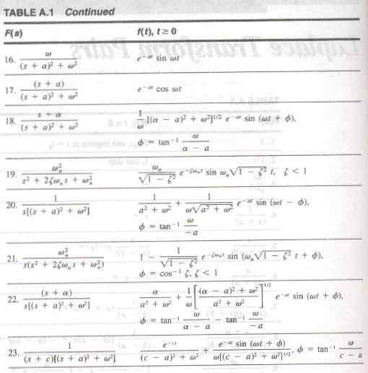
TABLE OF LAPLACE TRANSFORMS
Indian Institute of Information Technology - Allahabad

Slide 43

PRACTICE PROBLEMS(Laplace Transform Cont…)

Slide 44
PRACTICE PROBLEMS
(Solving Differential Equation using Laplace Transform)

Slide 45
PRACTICE PROBLEMS (Continued)

Slide 46
TABLE OF LAPLACE TRANSFORMS
Indian Institute of Information Technology - Allahabad

Slide 47
TABLE OF LAPLACE TRANSFORMS
Indian Institute of Information Technology - Allahabad

Slide 48
TABLE OF LAPLACE TRANSFORMS
Indian Institute of Information Technology - Allahabad

Slide 49
TABLE OF LAPLACE TRANSFORMS
Indian Institute of Information Technology - Allahabad

Slide 50
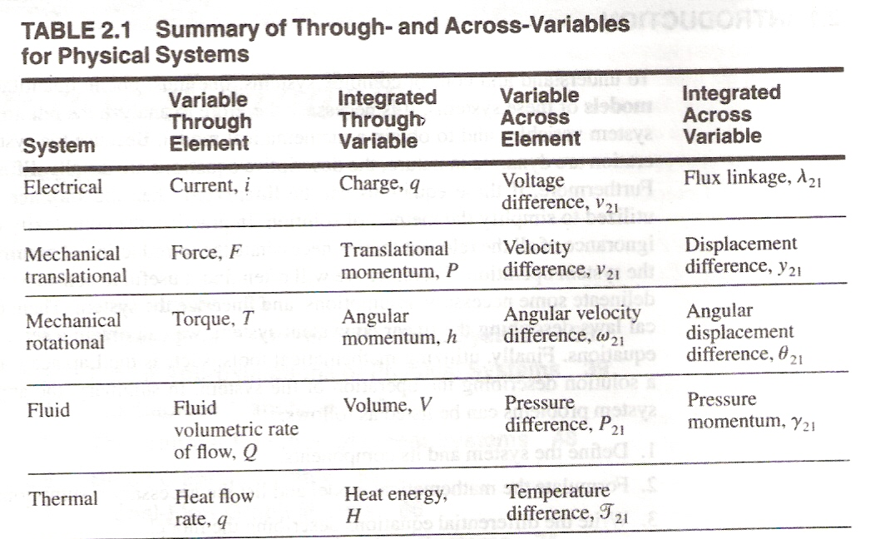
Indian Institute of Information Technology - Allahabad

Slide 51
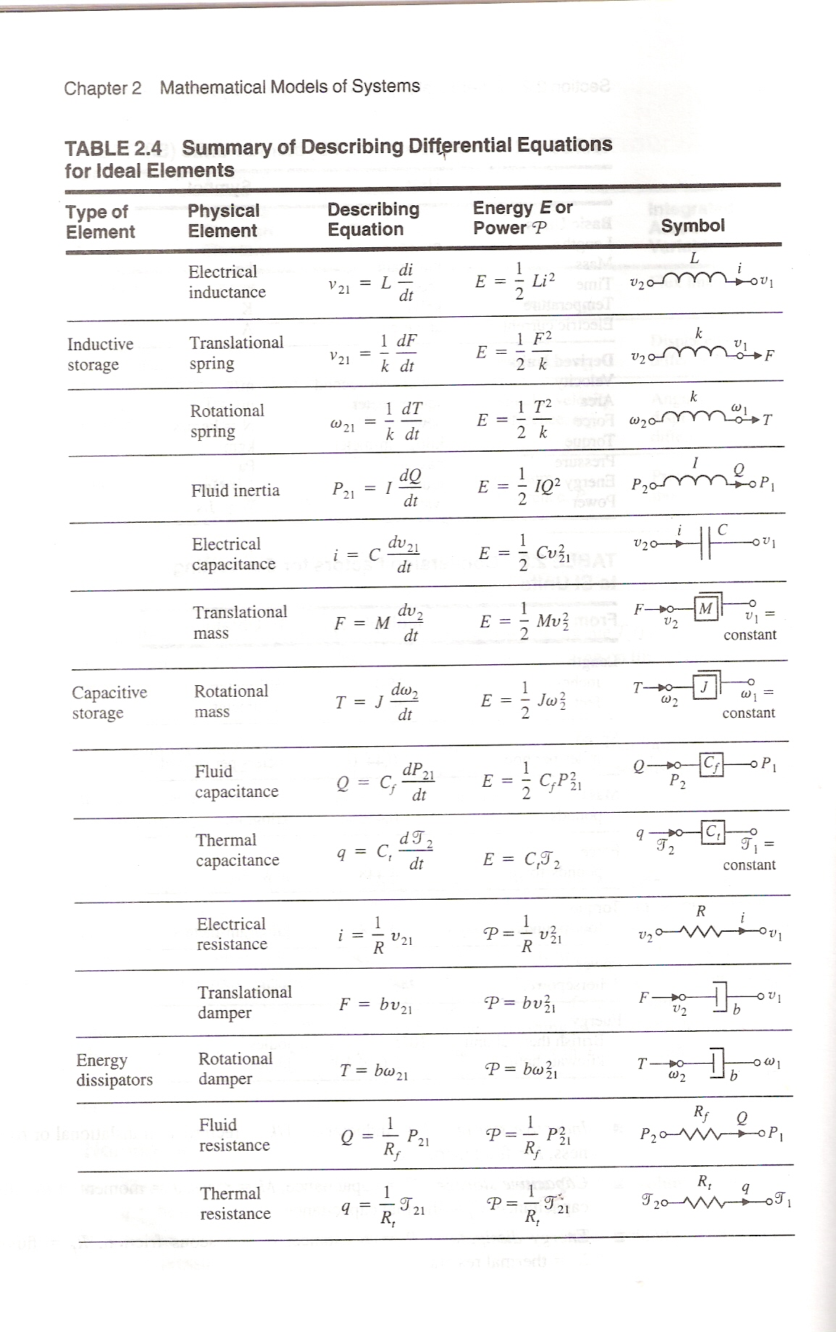
Indian Institute of Information Technology - Allahabad

Slide 52
(Continued)
Indian Institute of Information Technology - Allahabad

Slide 53
(Continued)
Indian Institute of Information Technology - Allahabad

Slide 54
Test Wave Forms use in Control Systems
Indian Institute of Information Technology - Allahabad

Slide 55
TABLE OF LAPLACE TRANSFORMS
Indian Institute of Information Technology - Allahabad

Slide 56
TABLE OF LAPLACE TRANSFORMS
Indian Institute of Information Technology - Allahabad

Slide 57
TABLE OF LAPLACE TRANSFORMS
Indian Institute of Information Technology - Allahabad

Slide 58
TABLE OF LAPLACE TRANSFORMS
Indian Institute of Information Technology - Allahabad

Slide 59
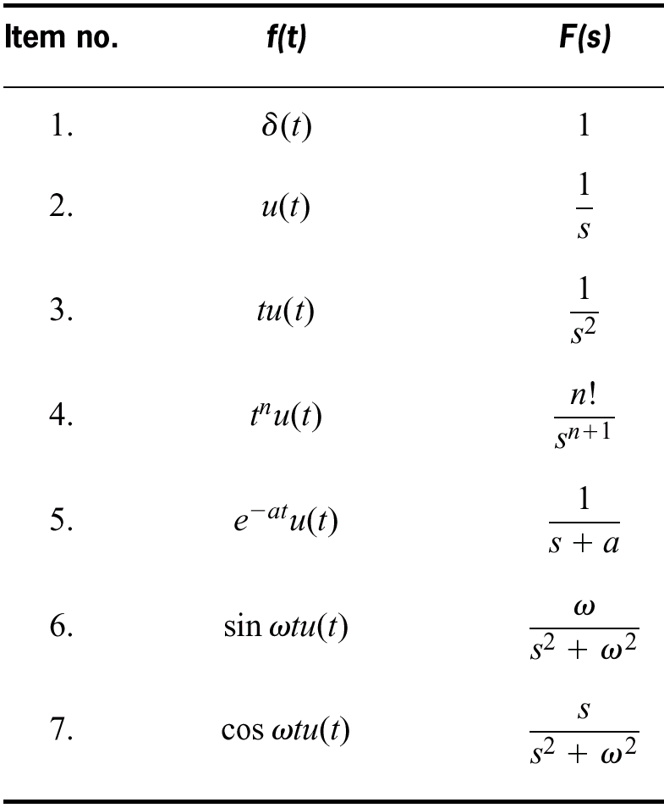
Table 2.1 Laplace transform table

Slide 60
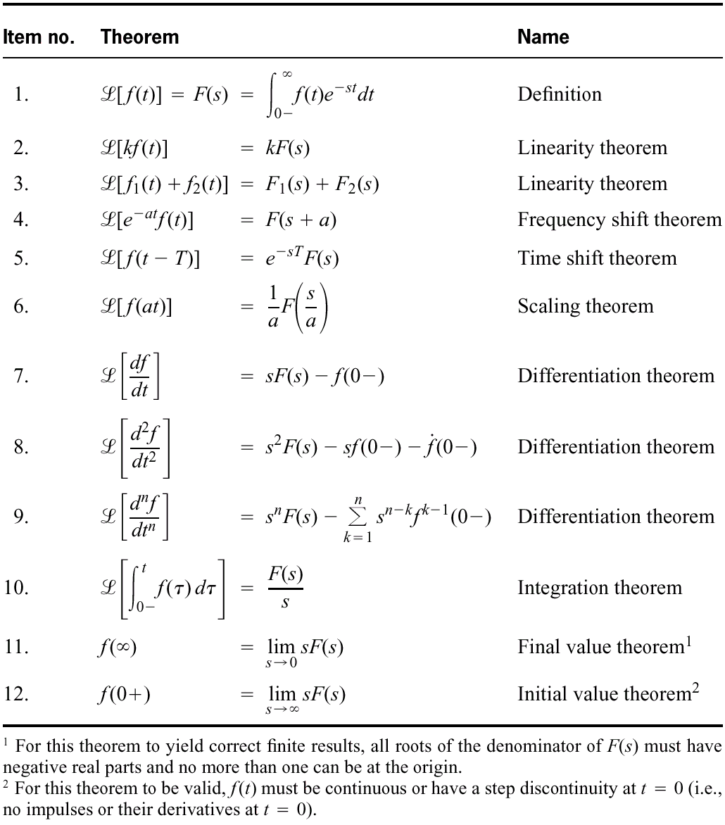
Table 2.2 Laplace transform theorems

Slide 61
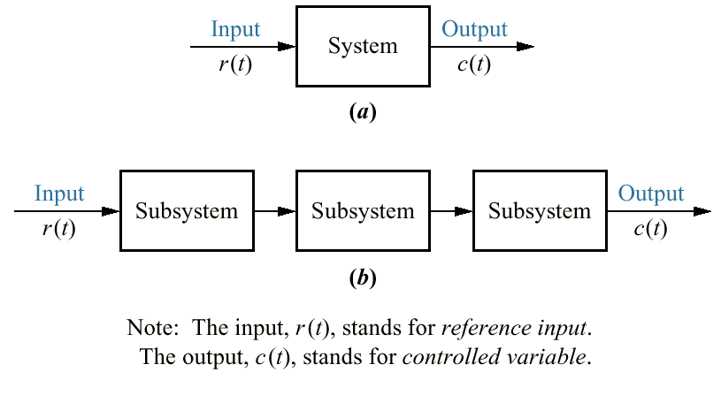
Figure 2.1 a. Block diagram representation of a system; b. Block diagram representation of an interconnection of subsystems

Slide 62
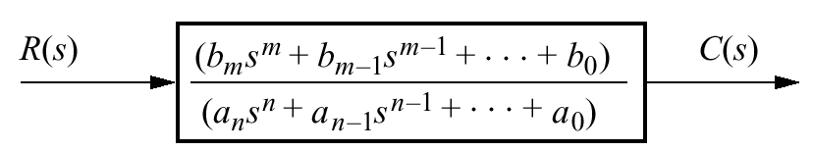
Figure 2.2 Block diagram of a Transfer Function

Slide 63
Problem: Find the transfer function represented buy
Solution: Taking the Laplace transform of both sides, assuming zero initial conditions we have

Slide 64
Test Wave Forms use in Control Systems
Indian Institute of Information Technology - Allahabad

Slide 65
For , a unit step, assuming zero initial condition are zero.

Slide 66
Indian Institute of Information Technology - Allahabad

Slide 67
Indian Institute of Information Technology - Allahabad

Slide 68
(Continued)
Indian Institute of Information Technology - Allahabad

Slide 69
(Continued)
Indian Institute of Information Technology - Allahabad

Slide 70
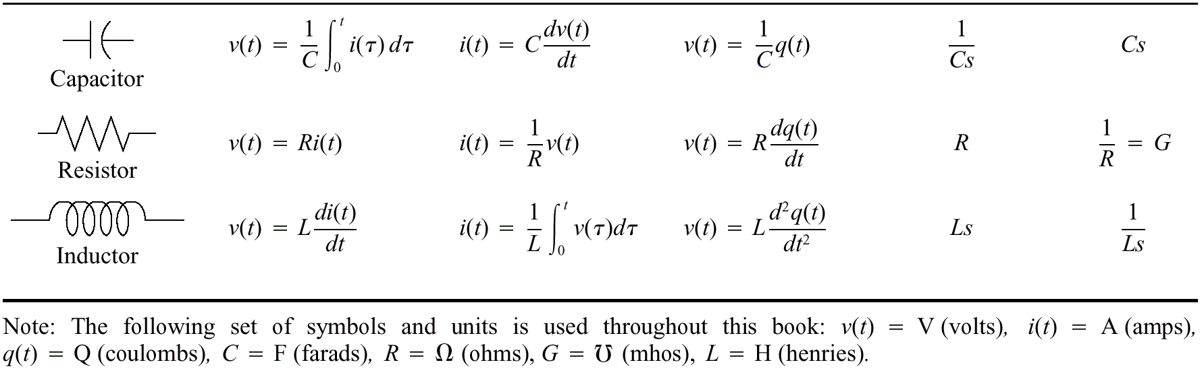
Table 2.3 Voltage-current, voltage-charge, and impedance relationships for capacitors, resistors, and inductors

Slide 71
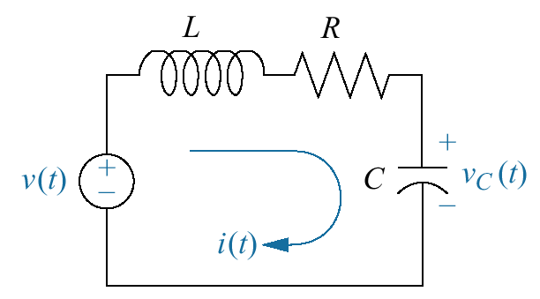
Figure 2.3 RLC network
(Page 53 Nise)
Laplace Transform:

Slide 72
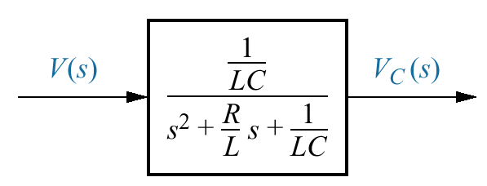
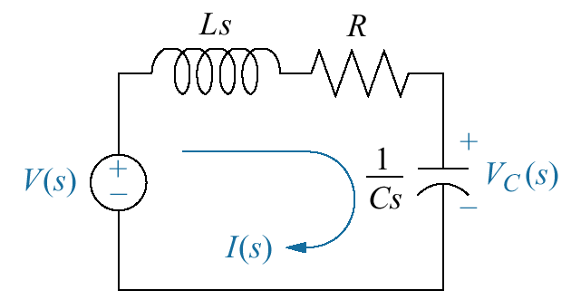
Figure 2.4 Block diagram of series RLC electrical network
Figure 2.5 Laplace-transformed network

Slide 73
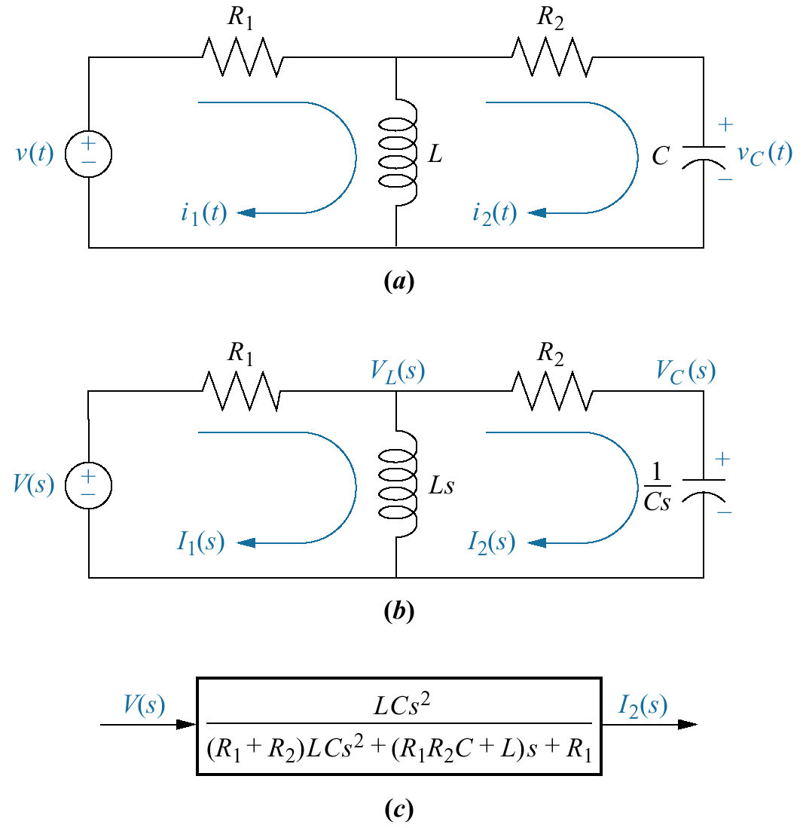
Figure 2.6 a. Two-loop electrical network; b. transformed two-loop electrical network; c. block diagram

Slide 74
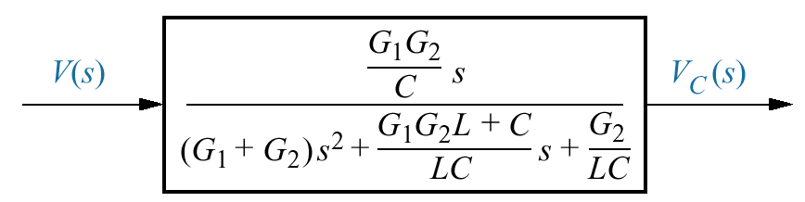
Figure 2.7 Block diagram of the network of Figure 2.6

Slide 75
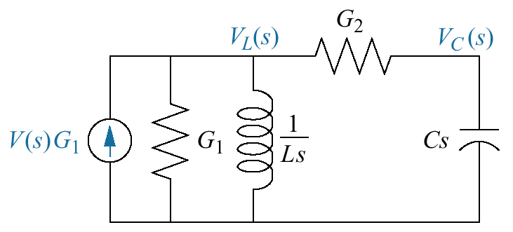
Figure 2.8 Transformed network ready for nodal analysis

Slide 76
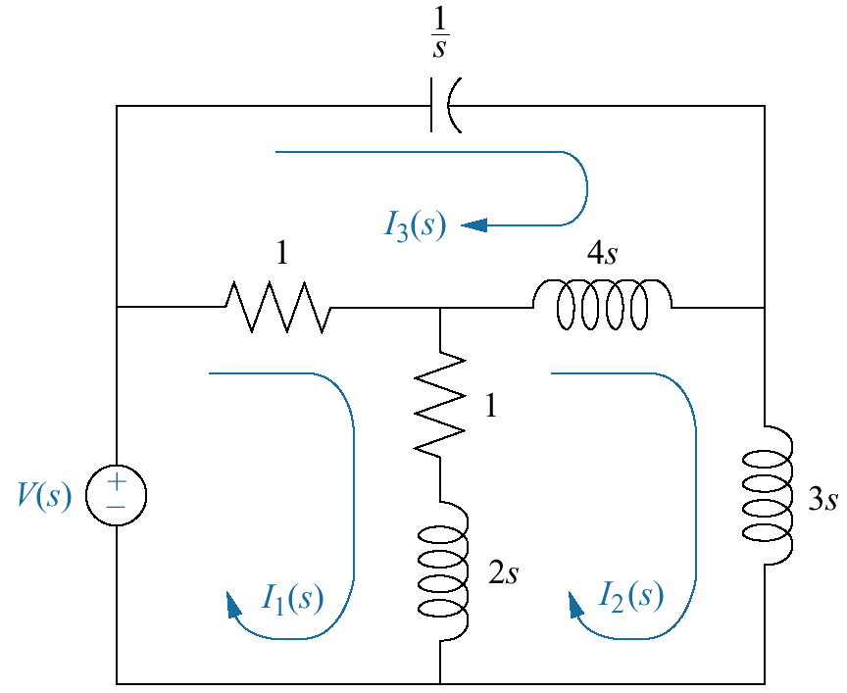
Figure 2.9 Three-loop electrical network

Slide 77
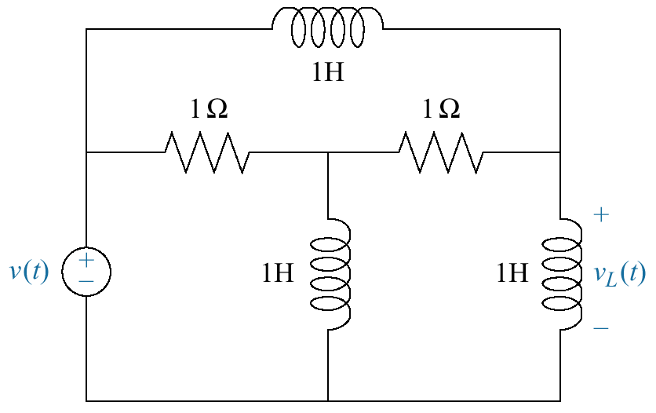
Figure 2.14 Electric circuit for Skill-Assessment Exercise 2.6

Slide 78
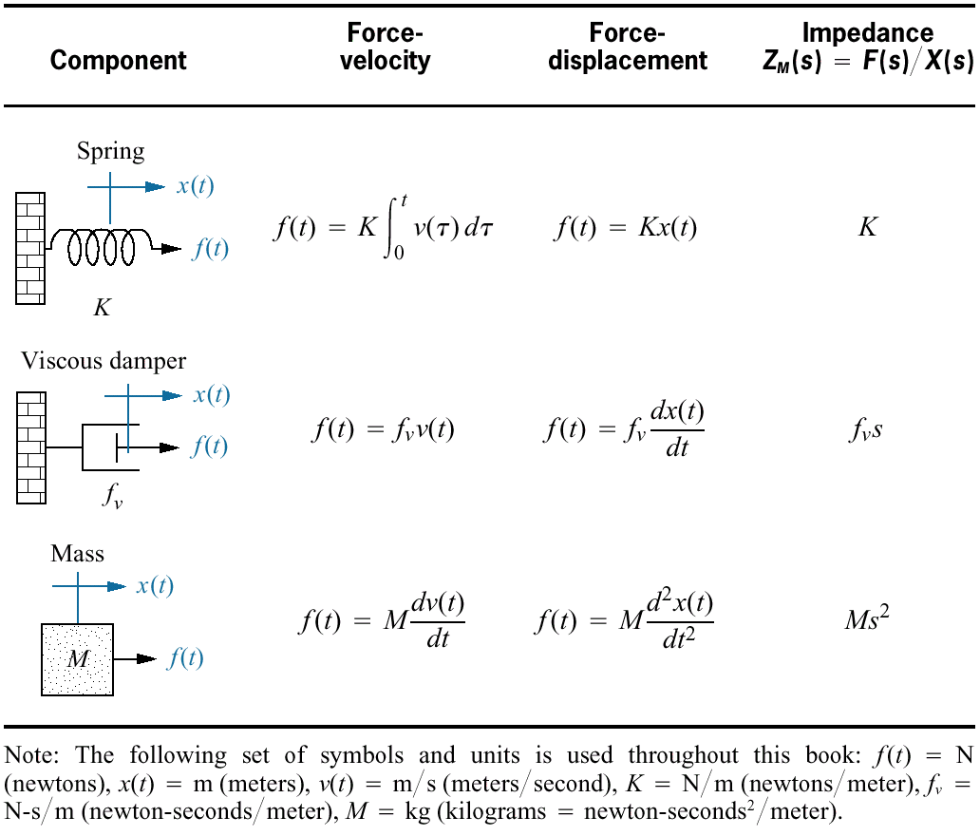
Table 2.4 Force-velocity, force-displacement, and impedance translational relationships for springs, viscous dampers, and mass

Slide 79
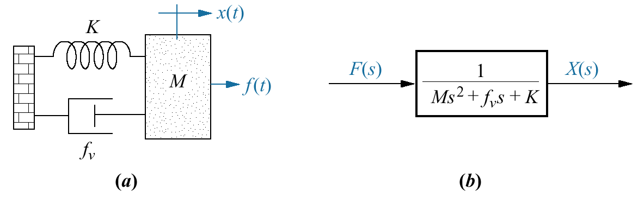
Figure 2.15 a. Mass, spring, and damper system; b. block diagram

Slide 80
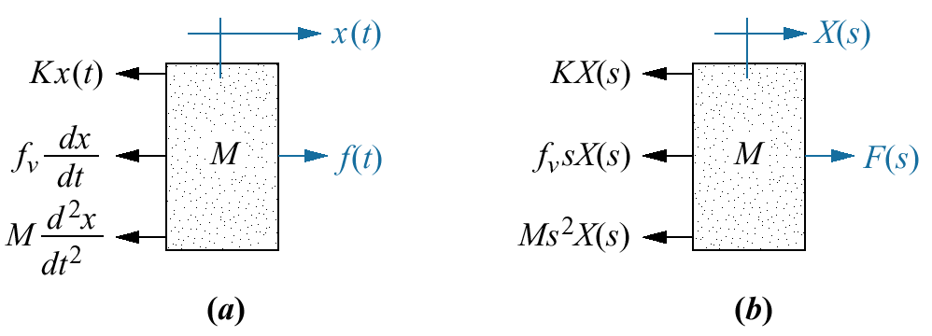
Figure 2.16 a. Free-body diagram of mass, spring, and damper system; b. transformed free-body diagram

Slide 81
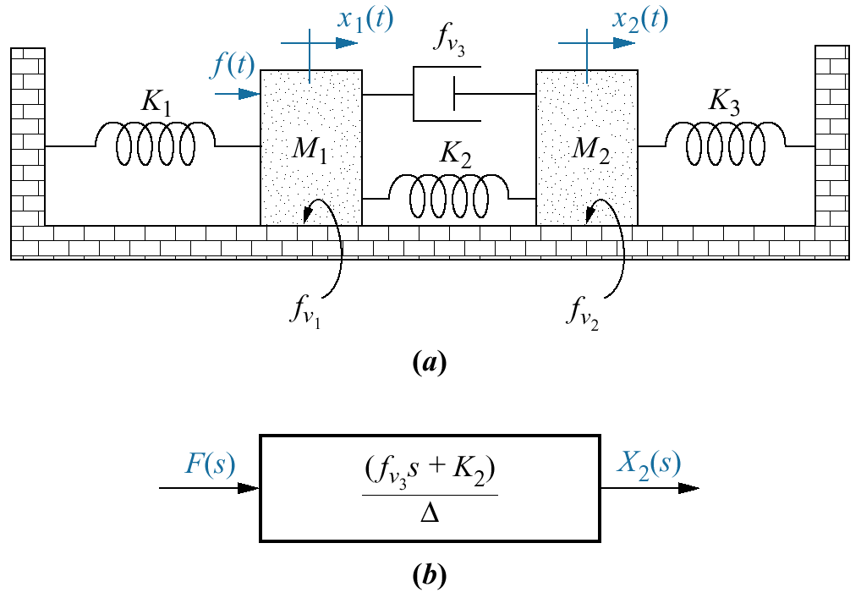
a. Two-degrees-of-freedom translational mechanical system⁸; b. block diagram
Figure 2.17

Slide 82
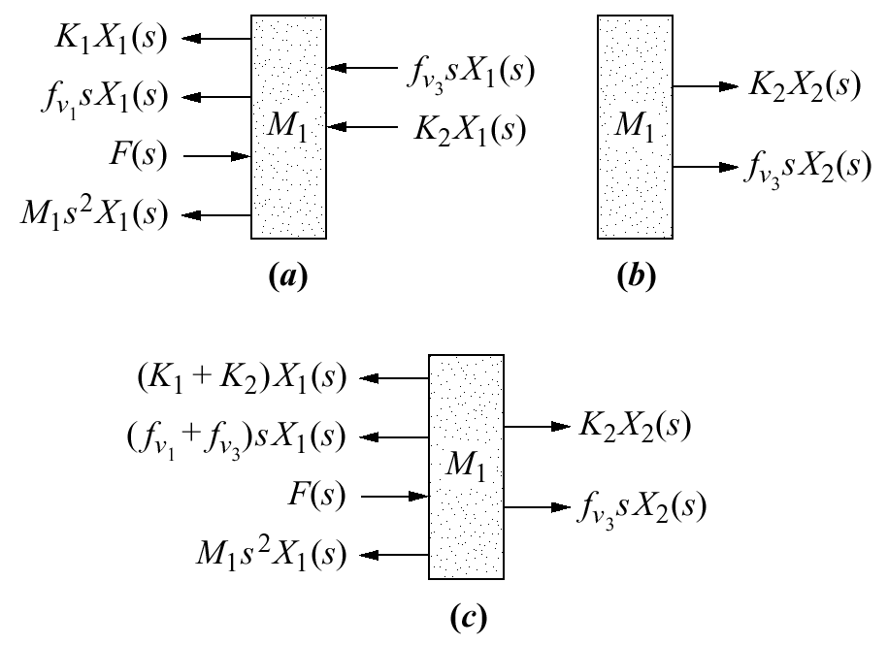
Figure 2.18 a. Forces on M₁ due only to motion of M₁ b. forces on M₁ due only to motion of M₂ c. all forces on M₁

Slide 83
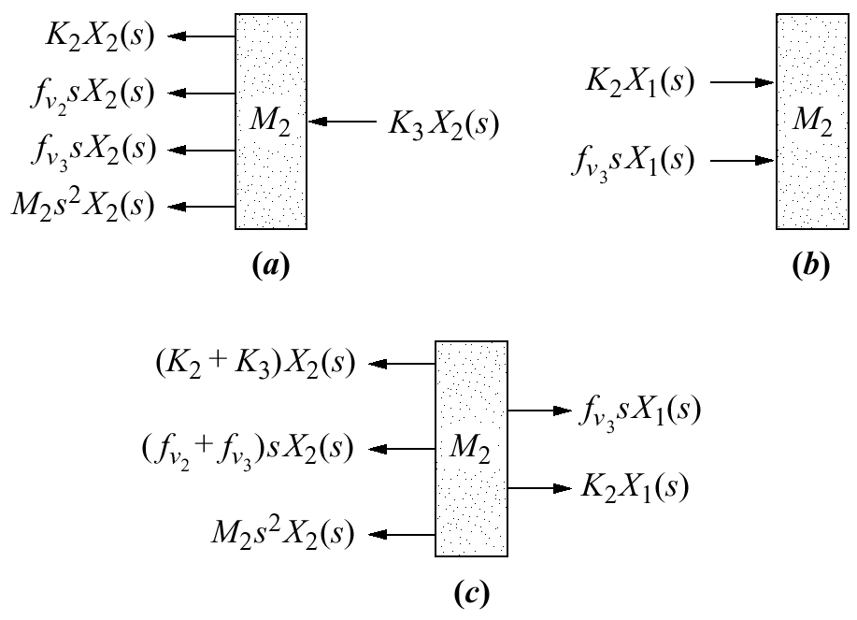
Figure 2.19 a. Forces on M₂ due only to motion of M₂; b. forces on M₂ due only to motion of M₁; c. all forces on M₂

Slide 84
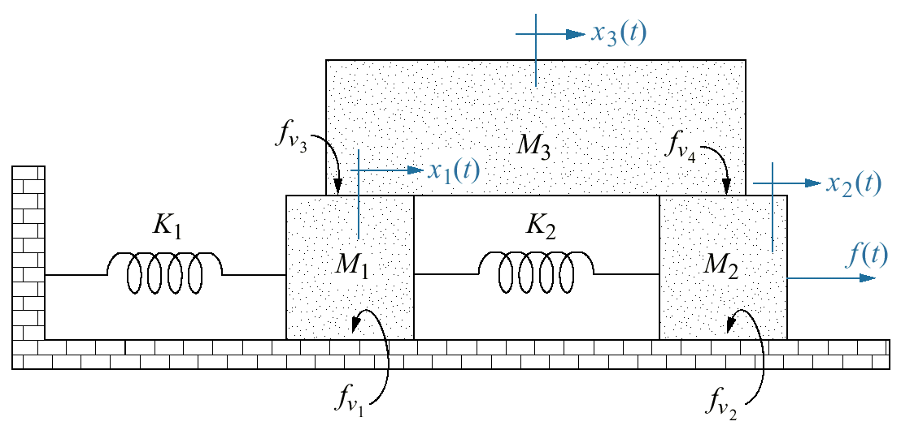
Figure 2.20 Three-degrees-of-freedom translational mechanical system

Slide 85
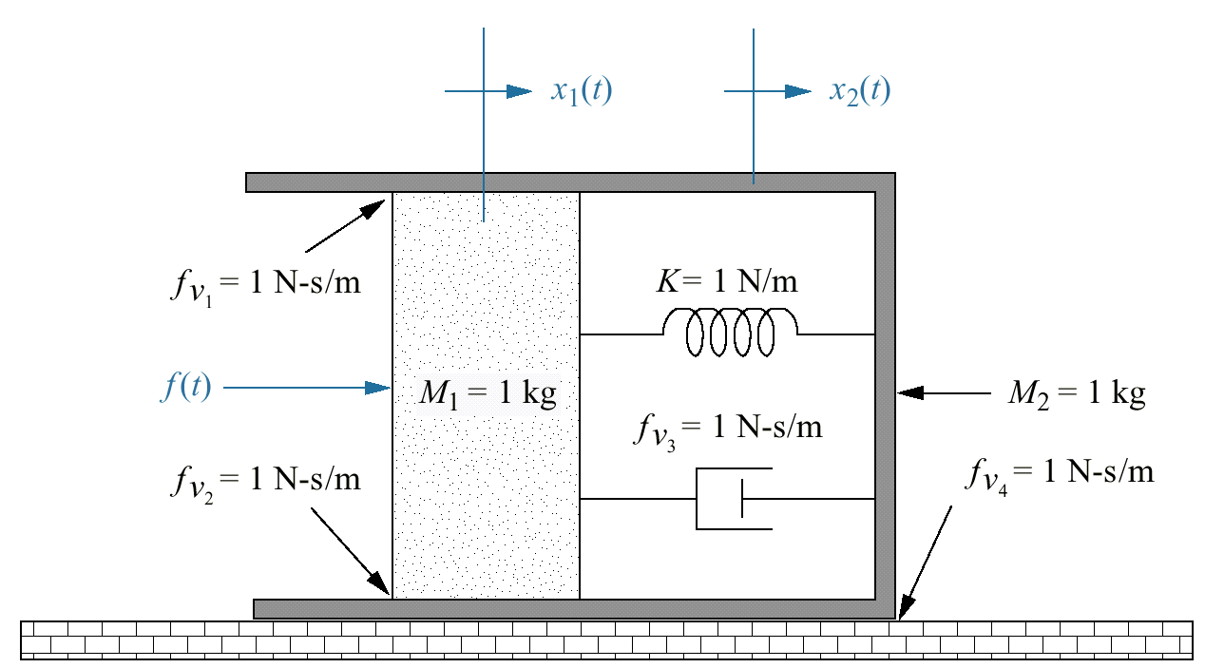
Figure 2.21 Translational mechanical system for Skill-Assessment Exercise 2.8

Slide 86
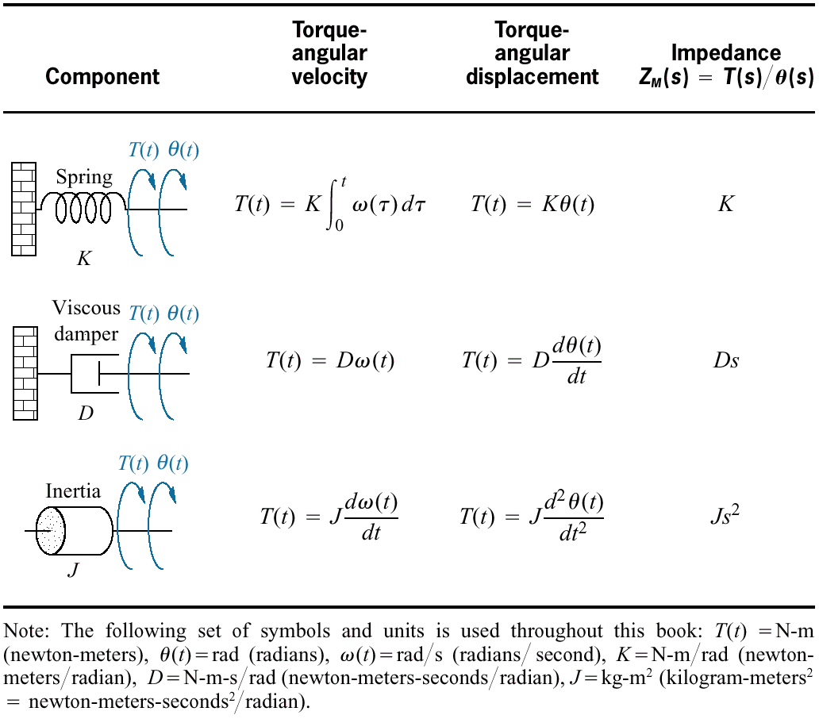
Table 2.5 Torque-angular velocity, torque-angular displacement, and impedance rotational relationships for springs, viscous dampers, and inertia

Slide 87
Indian Institute of Information Technology - Allahabad

Slide 88

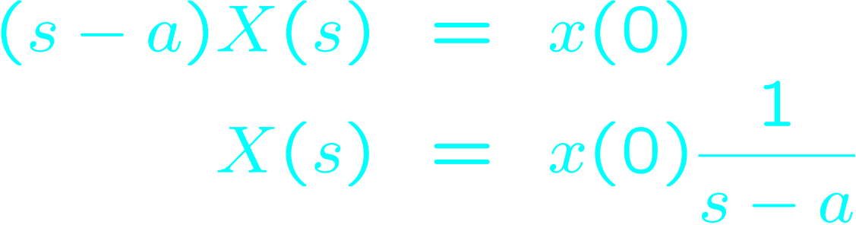
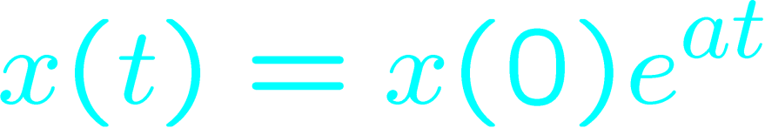
Homogenous (aka Autonomous / no input) 1st order linear ODE
Solve:
Do the Laplace transform
Do simple algebra
Take inverse transform
Known as zero input response

Slide 89

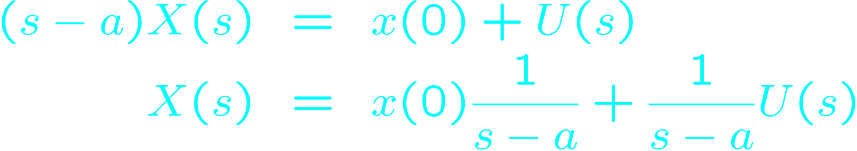
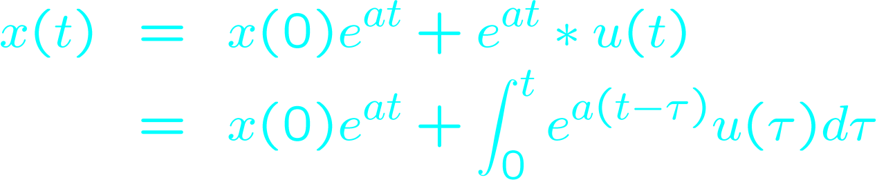
1st order linear ODE with input (non-homogenous)
Solve:
Do the Laplace transform
Do simple algebra
Take inverse transform
Known as the zero state response

Slide 90
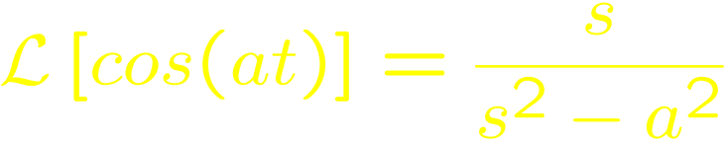

Example: a 2nd order system
Solve:
Do the Laplace transform
Do simple algebra
Take inverse transform

Slide 91
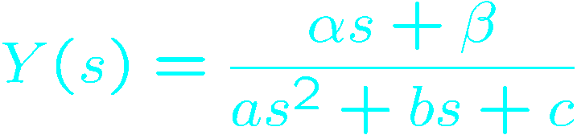
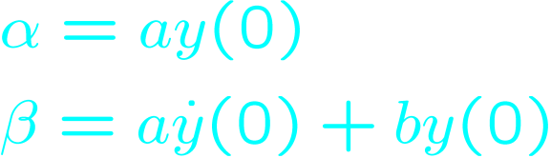
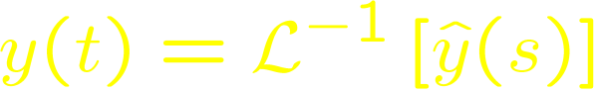
Using Laplace Transform to Analyze a 2nd Order system
Consider the autonomous (homogenous) 2nd order system
To find y(t), take the Laplace transform (to get an algebraic equation in s)
Do some algebra
Find y(t) by taking the inverse transform
characteristic polynomial
determined by Initial condition

Slide 92
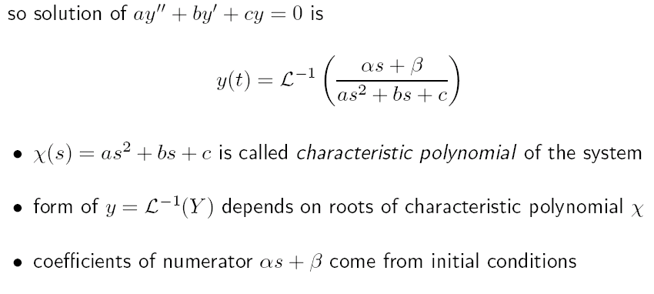

Slide 93
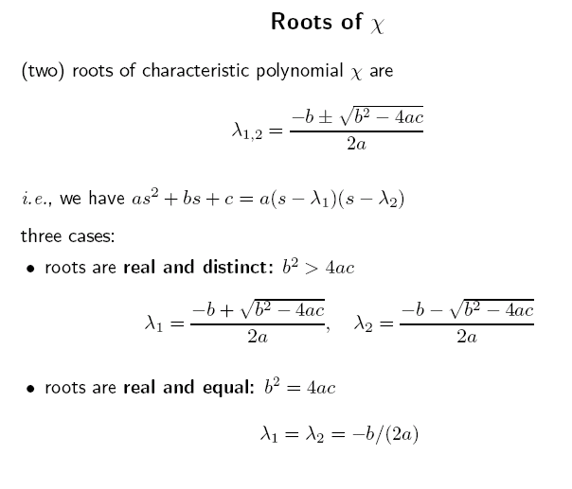

Slide 94
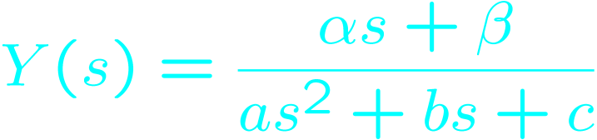
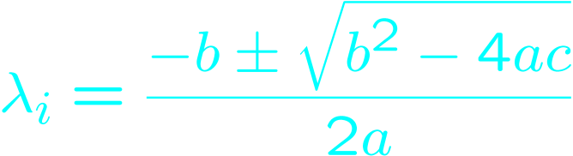
2nd Order system - Inverse Laplace
Solution of inverse transform depends on nature of the roots λ₁,λ₂ of the characteristic polynomial p(s)=as²+bs+c:
real & distinct, b²>4ac
real & equal, b²=4ac
complex conjugates b²<4ac
In shock absorber example: a=m, b=damping coeff., c=spring coeff.
We will see: Re{λ}→ exponential effect Im{λ}→ Oscillatory effect

Slide 95
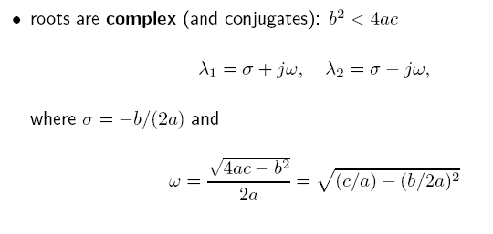

Slide 96
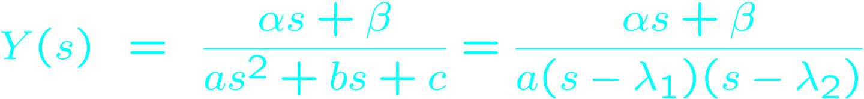
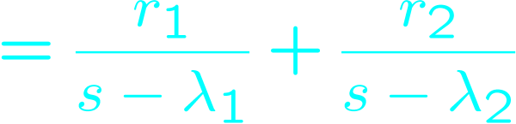
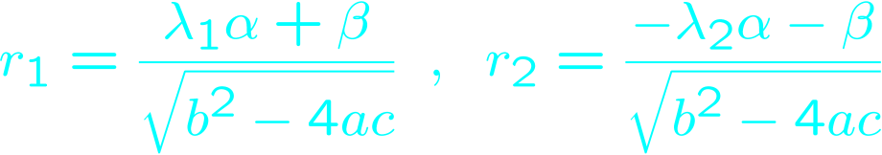
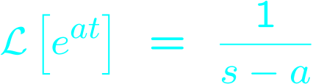


Real & Distinct roots (b²>4ac)
Some algebra helps fit the polynomial to Laplace tables.
Use linearity, and a table entry To conclude:
Sign{λ} → growth or decay
|λ| → rate of growth/decay
p(s)=s²+3s+1 y(0)=1,y’(0)=0 λ₁=-2.62 λ₂=-0.38
y(t)=-0.17e^{-2.62t}+1.17e^{-0.38t}

Slide 97





Real & Equal roots (b²=4ac)
Some algebra helps fit the polynomial to Laplace tables.
Use linearity, and a some table entries to conclude:
Sign{λ} → growth or decay
|λ| → rate of growth/decay
p(s)=s²+2s+1 y(0)=1,y’(0)=0 λ₁=-1
y(t)=-e^{-t}+te^{-t}

Slide 98




Complex conjugate roots (b²<4ac)
Some algebra helps fit the polynomial to Laplace tables.
Use table entries (as before) to conclude:
Reformulate y(t) in terms of σ and ω Where:

Slide 99


Complex conjugate roots (b²<4ac)
E.g. p(s)=s²+0.35s+1 and initial condition y(0)=1 , y’(0)=0
Roots are λ=σ+iω=-0.175±i0.9846
Solution has form: with constants A=|λ|=1.0157 r=0.5-i0.0889 φ=arctan(Im(r)/Re(r)) =-0.17591
Solution is an exponentially decaying oscillation
Decay governed by σ oscillation by ω.

Slide 100


Slide 101


Slide 102


Slide 103

The “Roots” of a Response
Im(s)
Marginally Stable
Stable
Unstable
Re(s)

Slide 104


Slide 105


Slide 106


Slide 107


Slide 108


Slide 109


Slide 111

Figure 4.10 Step responses for second-order system damping cases

Slide 112
The “Roots” of a Response
Im(s)
Marginally Stable
X
Stable
X
X
Unstable
X
X
X
X
X
X
Re(s)

Slide 113


Slide 114


Slide 115




Figure 5.14 Second-order feedback control system

Slide 116




Figure 5.15 Feedback system for Example 5.3

Slide 117

Figure 5.16 Feedback system for Example 5.4

Slide 118
(Optional) Reading List
LTI systems:
Chen, 2.1-2.3
Laplace:
http://www.cs.huji.ac.il/~control/handouts/laplace_Boyd.pdf
Also, Chen, 2.3
2nd order LTI system analysis:
http://www.cs.huji.ac.il/~control/handouts/2nd_order_Boyd.pdf
Linear algebra (matrix identities and eigenstuff)
Chen, chp. 3
Stengel, 2.1,2.2

